Slide 1
Ionic Bonds & Structure

Slide 2
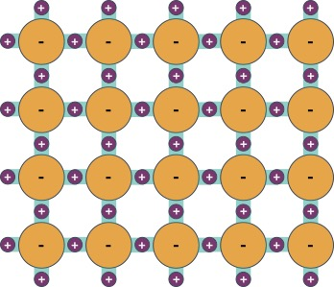





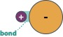
Terminology
Bond
Structure
Relationship between pairs
Relationship between groups

Slide 3
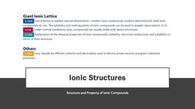
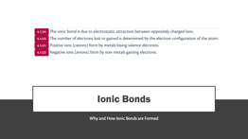
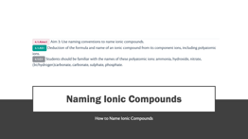
Navigation

Slide 4
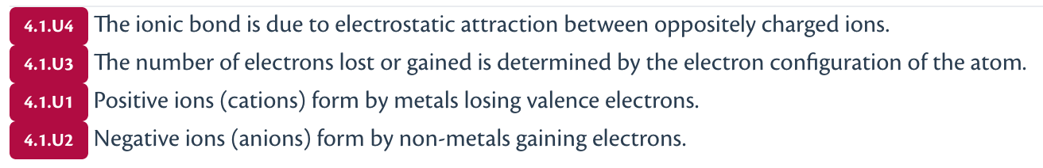
Ionic Bonds
Why and How Ionic Bonds are Formed

Slide 5
Stable electron configurations
Na⁰: 1s² 2s² 2p⁶ 3s¹
Na⁺: 1s² 2s² 2p⁶
F⁰: 1s² 2s² 2p⁵
F ⁻: 1s² 2s² 2p⁶

Slide 6
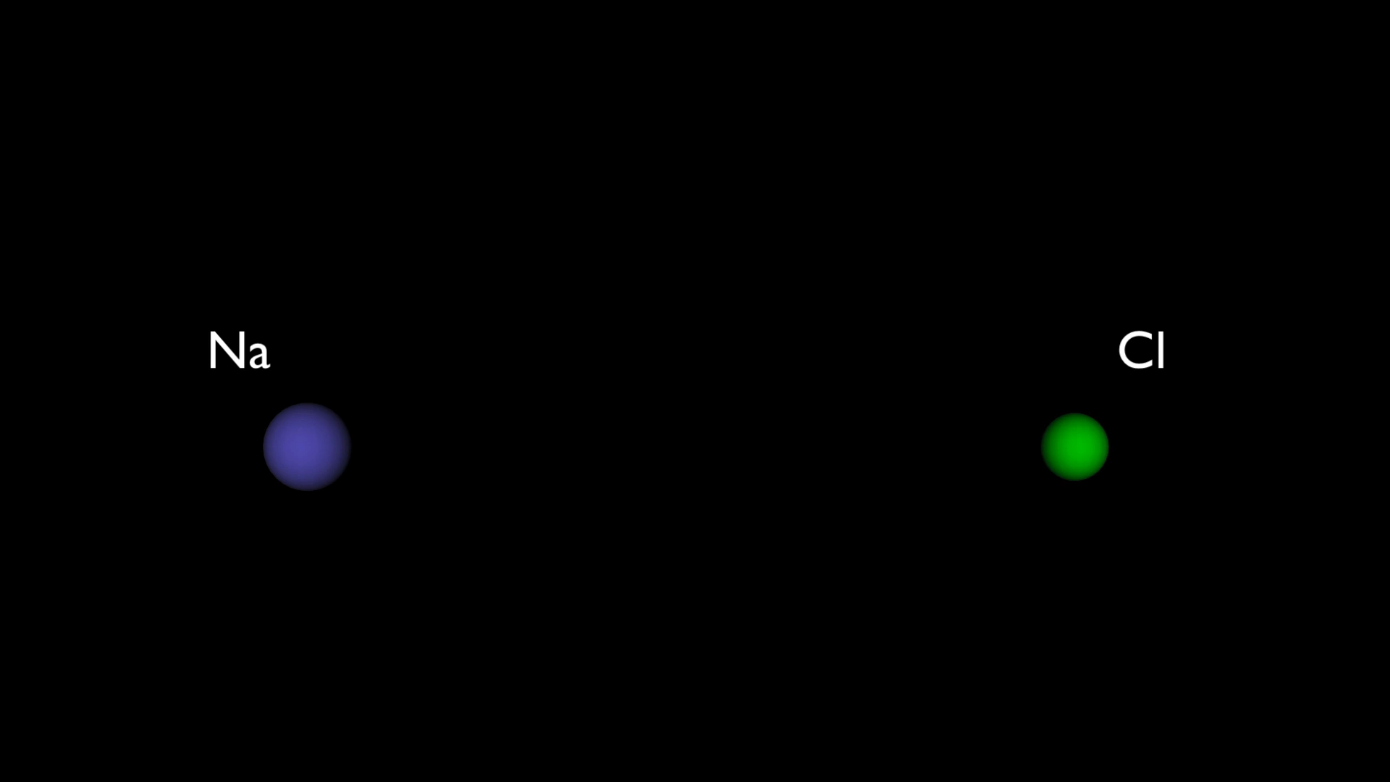
Electron transfer (redox) reaction

Slide 7
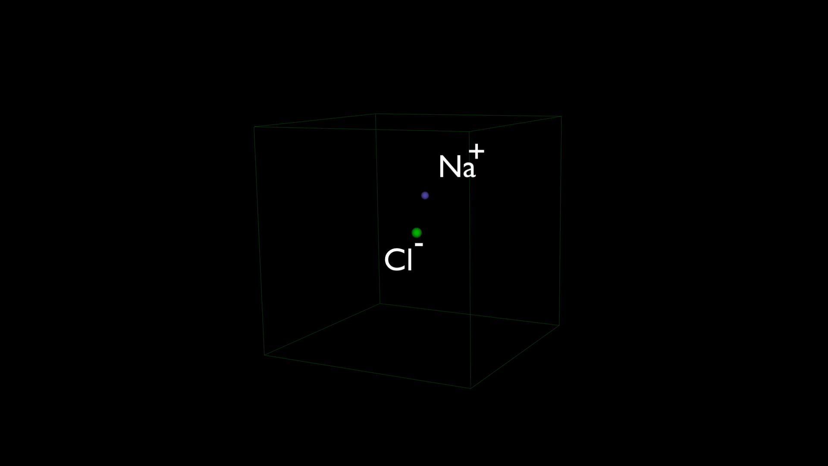
Attraction between ion pairs
Ionic bond is the electrostatic attraction between oppositely charged ions.

Slide 8
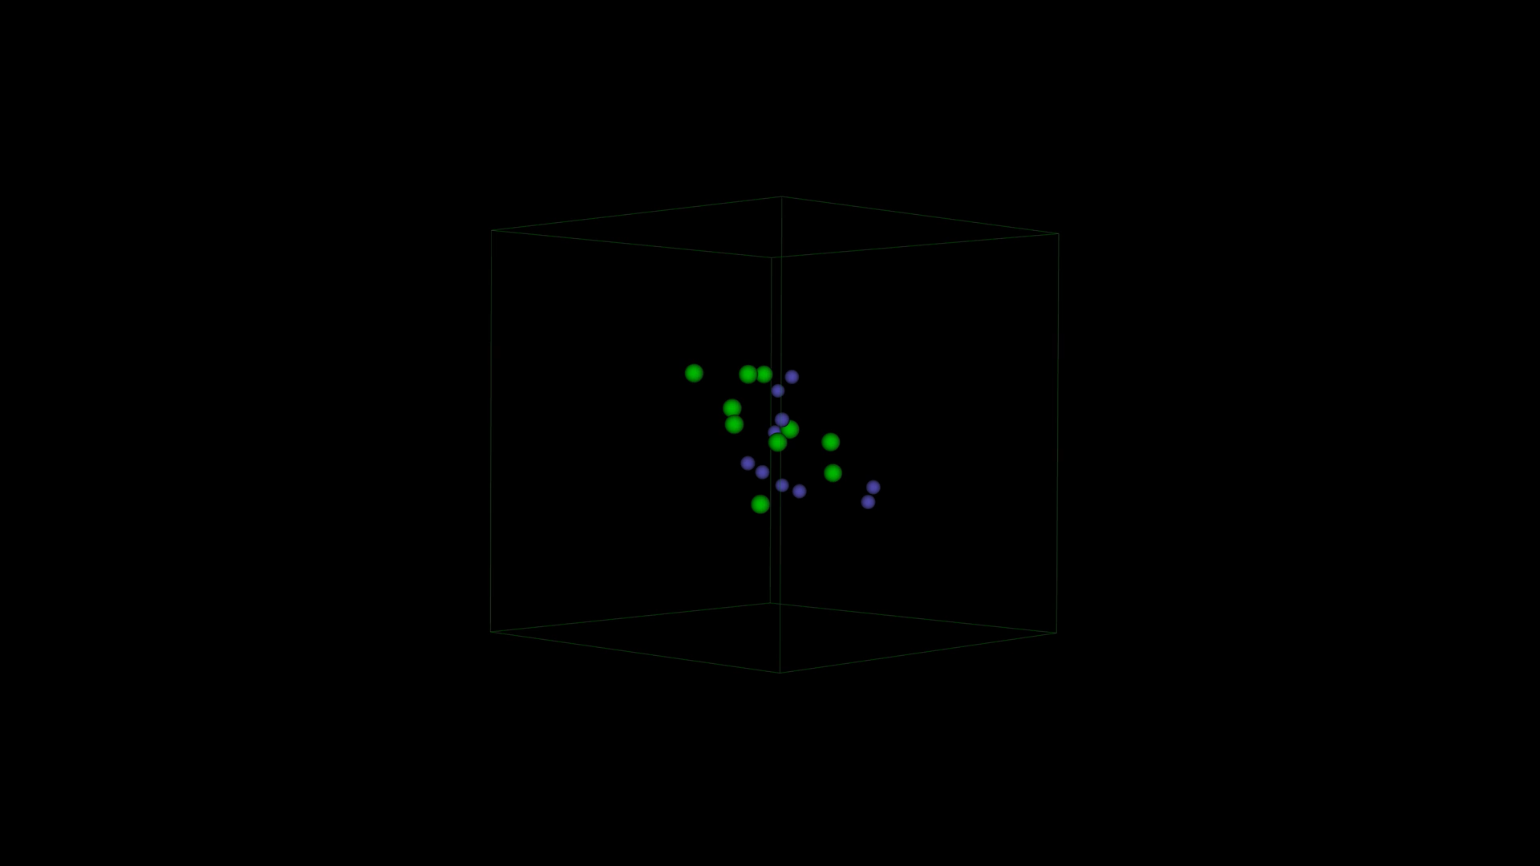
Progression from Bonding to Structure

Slide 9
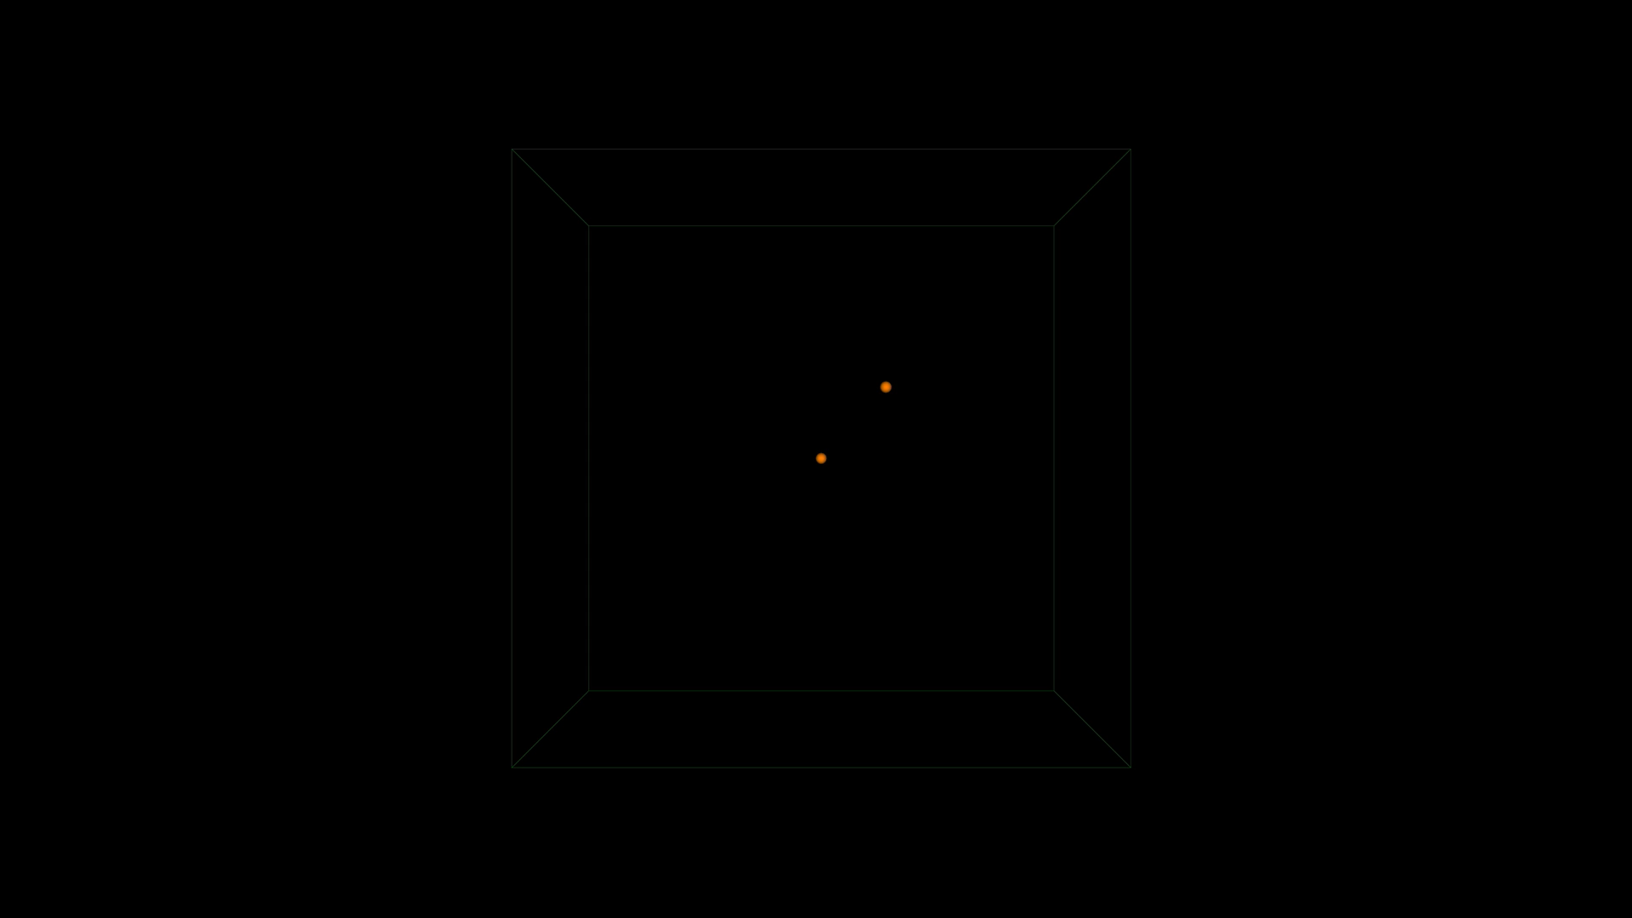
Stoichiometry

Slide 10
Deducing a stable formula
Stable ionic compounds are electrically neutral (i.e., no overall charge)
Same number of +.ve charges as -.ve charges
Find charge of cation
Find charge of anion
Cross multiply, simplify
If not given, use periodic table to reason

Slide 11
Polyatomic ions
Cations
Ammonia NH₄⁺
Anions
Hydroxide OH⁻
Nitrate NO₃⁻
Carbonate CO₃²⁻
Hydrogen carbonate (bicarbonate) HCO₃⁻
Sulphate SO₄²⁻
Phosphate PO₄³⁻

Slide 12
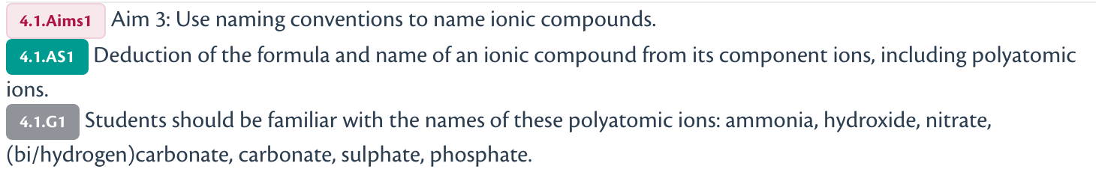
Naming Ionic Compounds
How to Name Ionic Compounds

Slide 13
Cation - Anion
Name the cation first, then the anion
The name does not indicate the stoichiometry
(after topic 9.1) add oxidation state for transition metal cations
Example: sodium and CO₃²⁻
Na -> Na⁺ -> sodium
CO₃²⁻ -> carbonate
(Na⁺)₂CO₃²⁻ -> Na₂CO₃ -> sodium carbonate

Slide 14
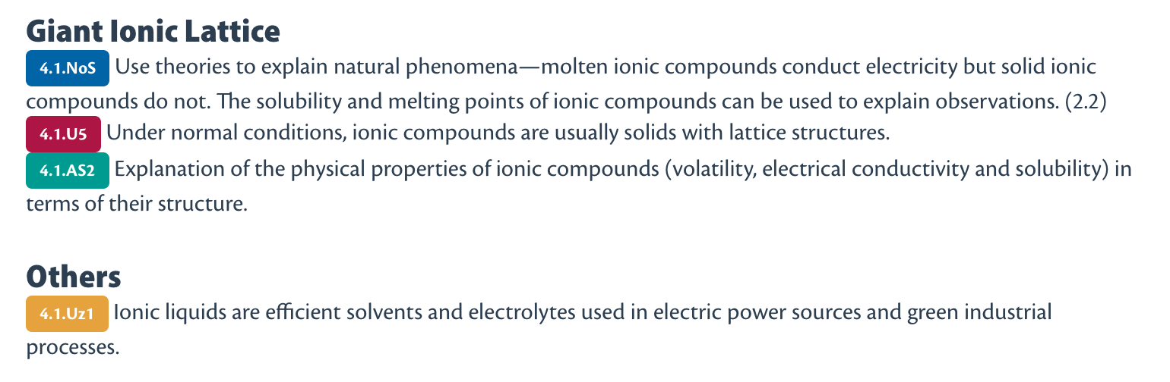
Ionic Structures
Structure and Property of Ionic Compounds

Slide 15
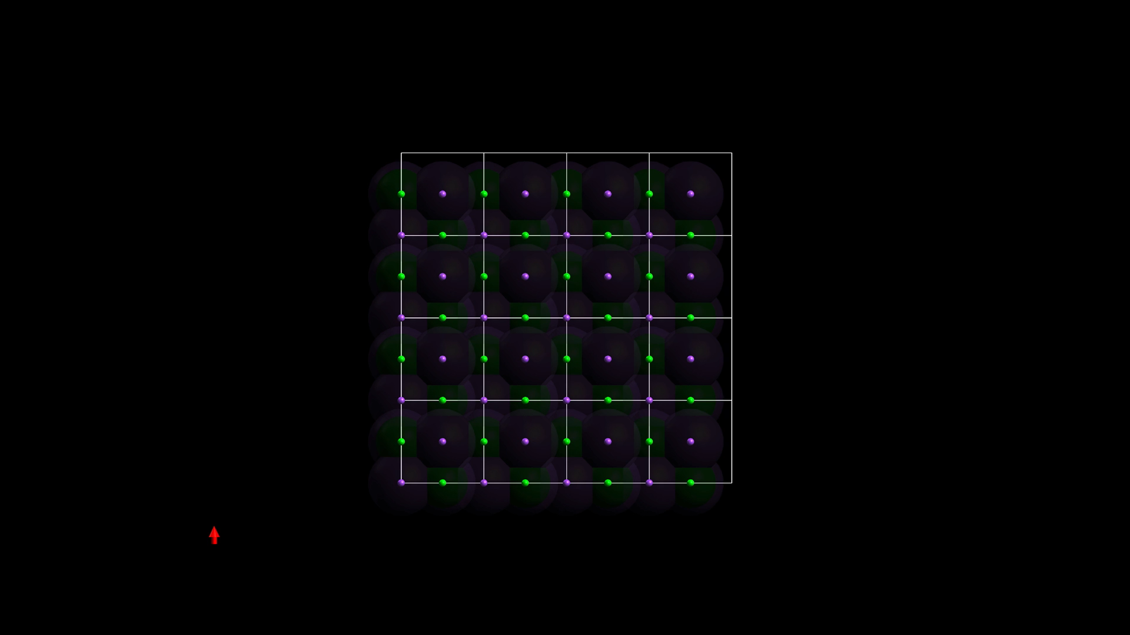
Ionic Lattice
Sometimes “giant ionic structure”
3D network of packed ions
Strongly attracted
High melting point
High boiling point
Not volatile
Limited motion
No mobile charge carriers
Not electrically conducting as solid

Slide 16
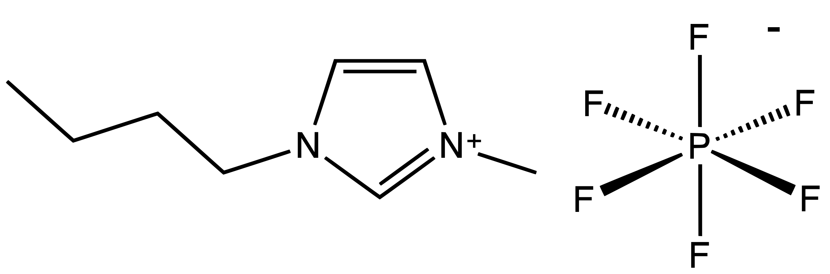
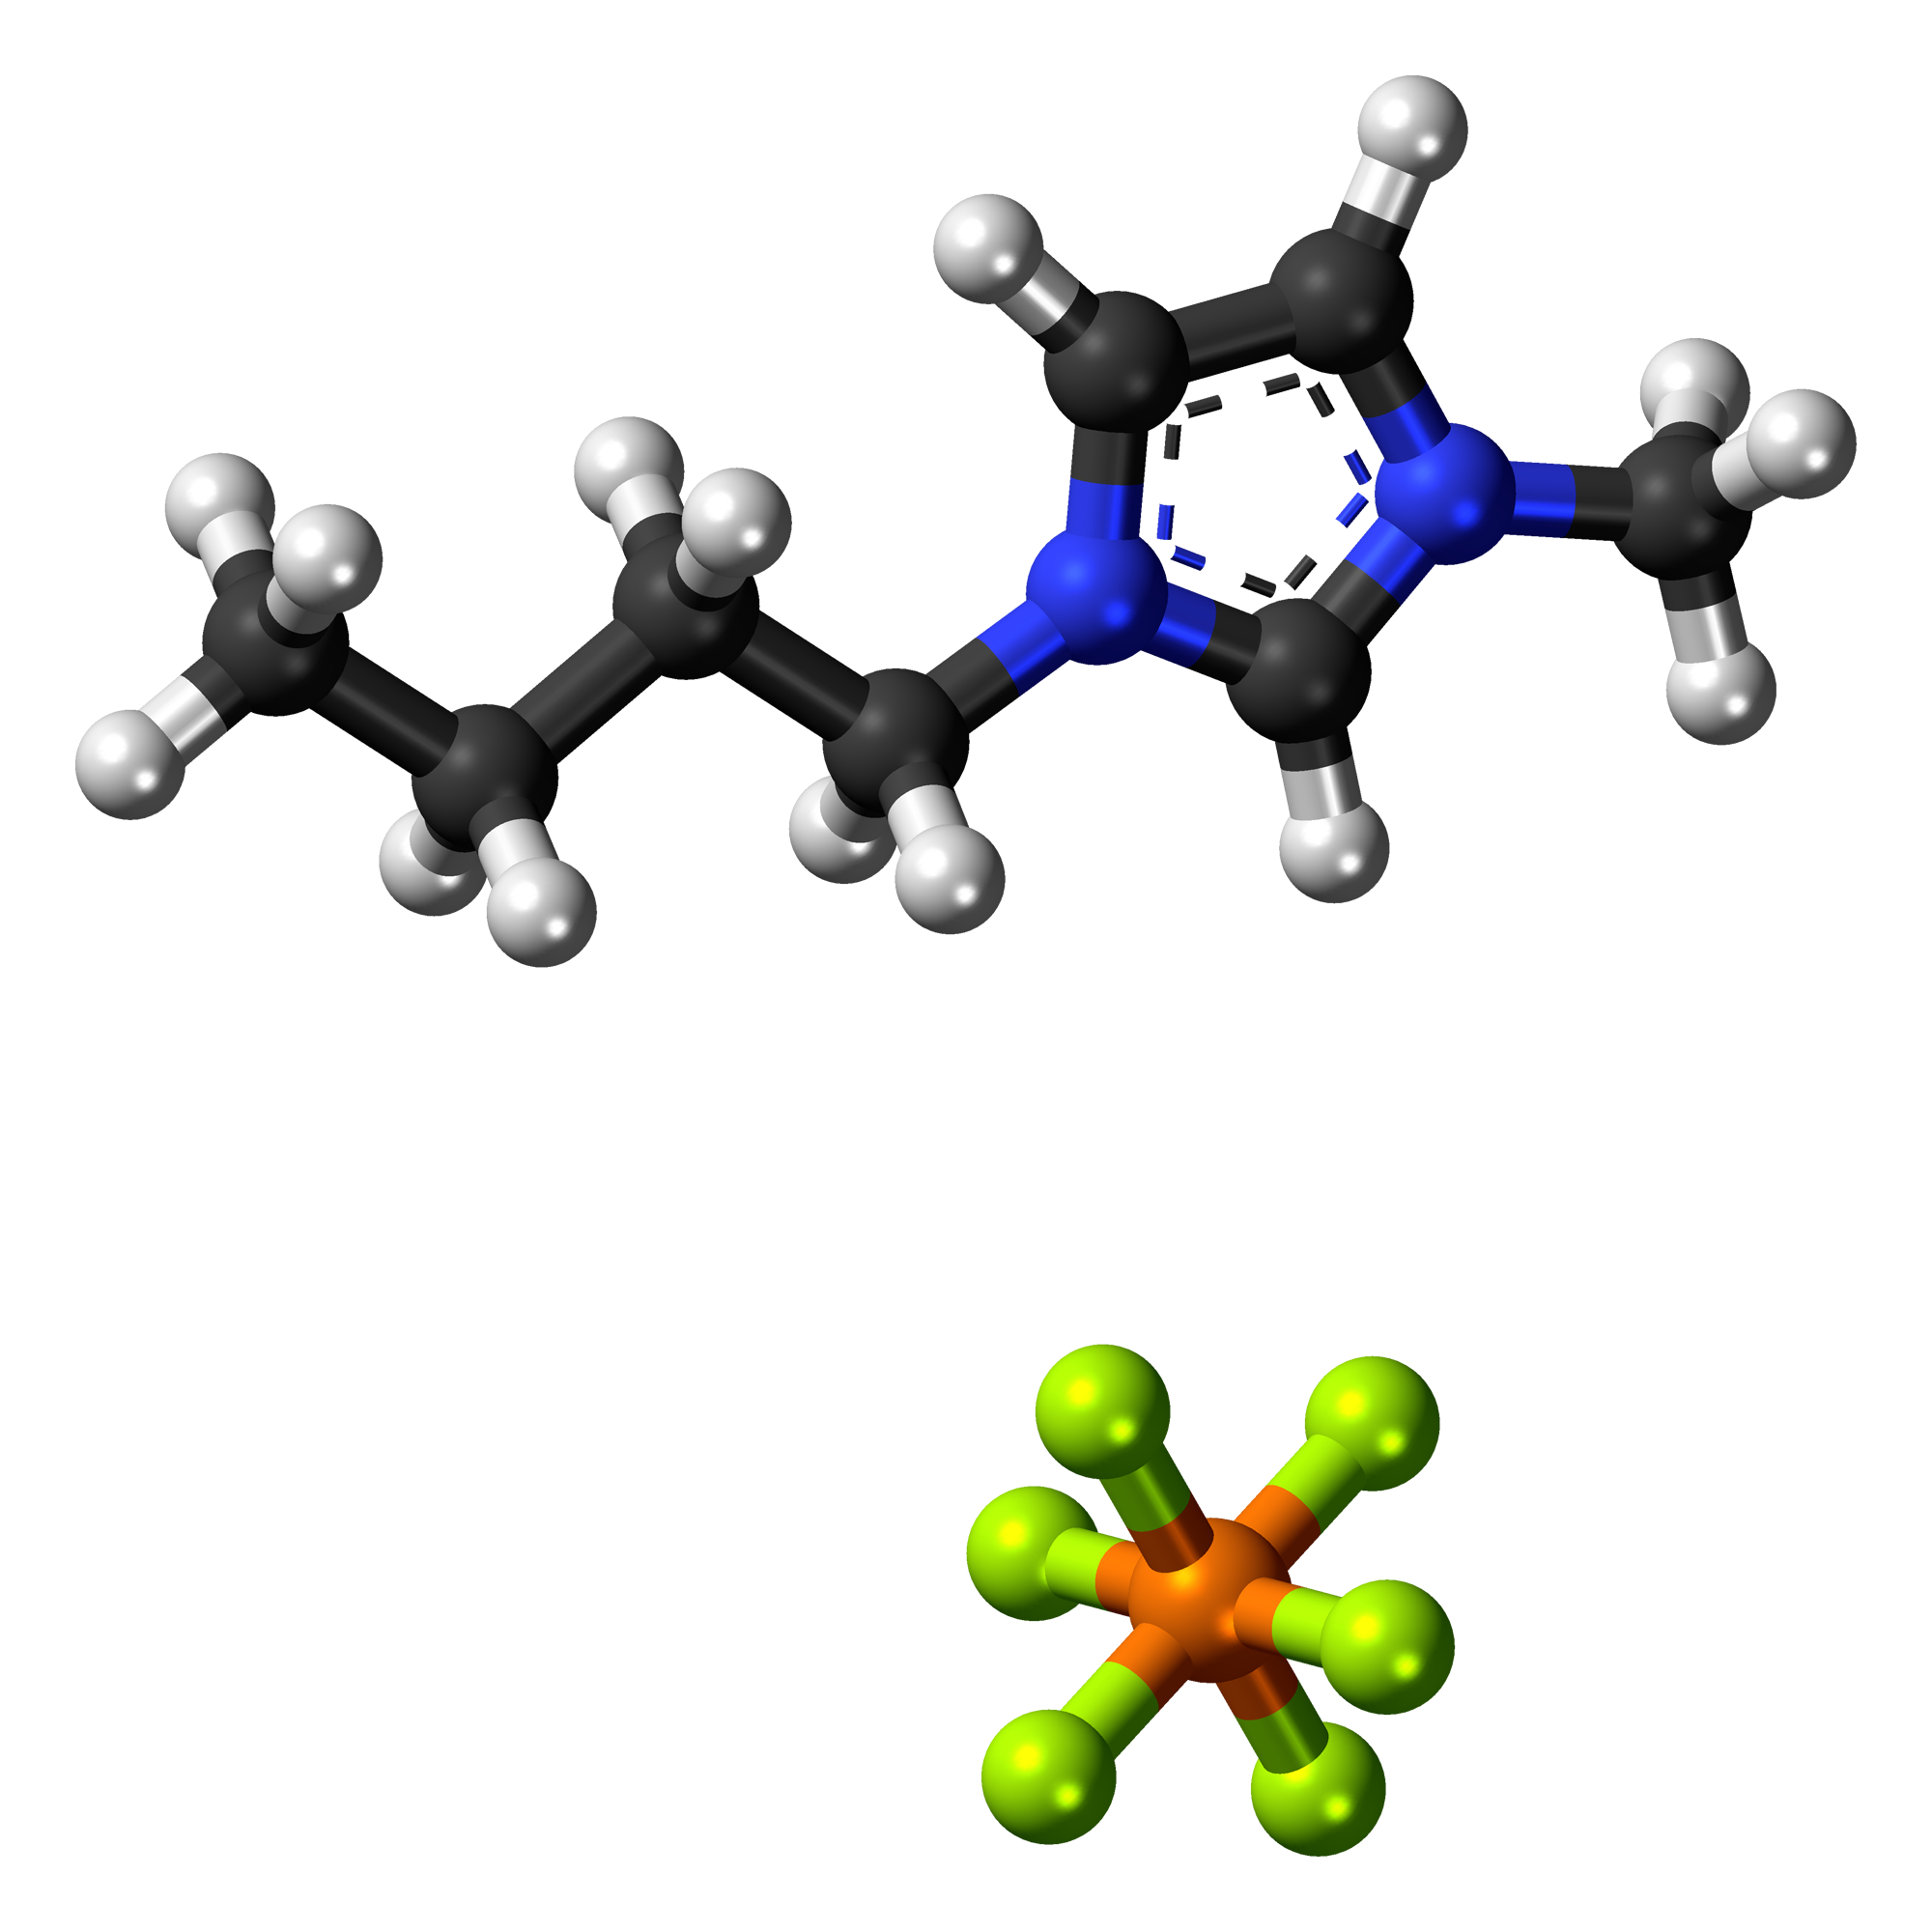
Ionic liquids
Cations & anions irregular in shape
Diffused charges
Cannot pack into a lattice effectively
Remains a liquid
Useful as solvents (e.g., green chemistry, dry-clean) and electrolytes (e.g., between the electrodes in battery)

